Slide 1
Training on Log-based
Field Failure Data Analysis
Domenico Cotroneo cotroneo@unina.it

Slide 2

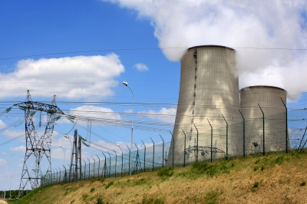
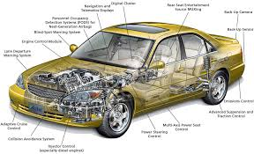
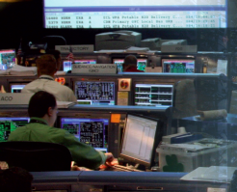
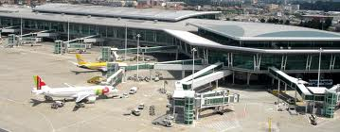
Data-driven Analysis
Textual logs and numeric data produced by applications, systems, and IDSs are a key resource to:
  characterize failures;
  predict problems;
  pinpoint security attacks;
  improve the system;
Data are available in many
critical systems!

Slide 3
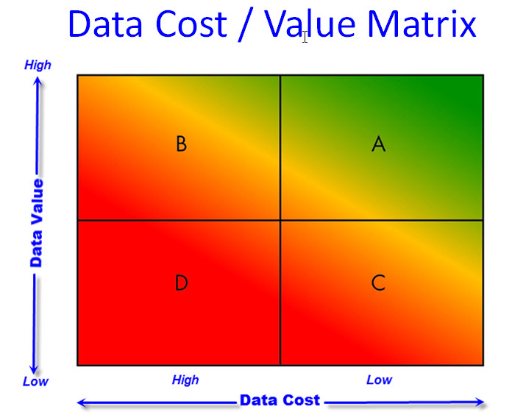
Not all the data is the same
IDS
network
audit
e.g.,
network
audit
event logs
Notes:
My experience is that most organizations are smothered in data. Typically it is the wrong data. All too often organizations focus their attention on the data they CAN get, and do not spend enough energy on the data they SHOULD get.
I shared the Data Cost / Value Matrix and described companies that I’ve known that live in each of the four quadrants. While most people aspire to Quadrant A (Low Cost and High Value data), most don’t live there in reality. Many actually live in Quadrant D (High Cost and Low Value).
While these anecdotal descriptions of the four quadrants are useful, they don’t offer much guidance on what to do about your current reality.
For that reason, I developed a quick and dirty Gap Analysis that helps you quantify where you are today. Used properly, the Gap Analysis can point you to some actions that can help you become more data driven.

Slide 4
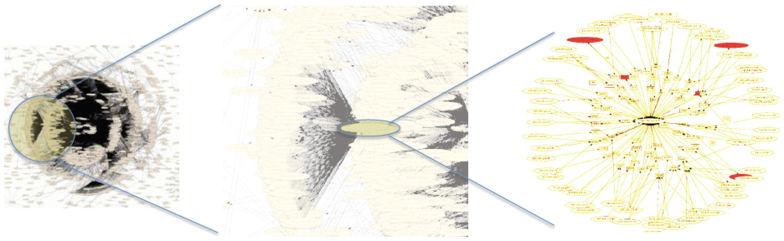
Challenges
Dealing with operational data is extremely hard:
  increasing network traffic and failure rates;
  increasing data volumes;
  data quality and heterogeneity;
  lack of systematic procedures;
  low automation degree;
  …
5min in-out traffic
of a data center

Slide 5
What is the training lesson about
Conducting a log-based FFDA of complex, large-scale systems.
Real data collected from:
  Mercury at the National Center for Supercomputing Application (NCSA at University of Illinois);
  BlueGene/L at the Lawrence Livermore National Labs (LLNL, CA, USA).

Slide 6
Goals
Objectives: to learn the basics in
  data classification/analysis;
  determining the coalescence window to group a set of error entries;
  performing a failure analysis;
  reliability modelling via well-know distributions;
  analysis at system and node level;
  …

Slide 7

Why is it hard?
Monitoring in a datacenter day …
25K SSH connections
7M network
packets (netflows)
2K IDS alerts
400K log entries (syslog)
300 major security alerts

Slide 8
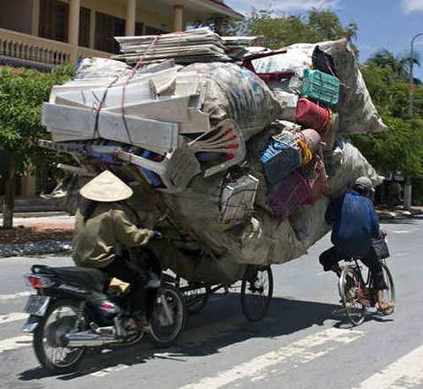
Even if the data is available, the real challenge is still being actually able to use it!

Slide 9

Why?
Failure characterization;
Failure correlation/localization;
Failure prediction;
Cause analysis;
Check-pointing tuning;
Failure-aware job
allocation;
…
Correct understanding
of the failure
behavior is a critical task!

Slide 10
Mercury cluster: overview
Mercury consists of IBM nodes. The cluster has a 3-layer architecture + a management node (tg-master)
“computation” nodes
“login” nodes
“storage” nodes
tg-master
ID of the nodes in
the log (X is an integer)
tg-loginX
tg-cX
tg-sX
Myrinet. The nodes run a RedHat 9.0 OS
Entries have been collected via the syslog daemon

Slide 11
Mercury event log
80,854 log filtered and anonimized entries (only FATAL error entries are given in the log)
Format:
  Timestamp
  Originating node
  Originating subsystem
  Text-free message
1167667229 tg-c238 DEV
Component Info: Vendor Id =* *, Device Id =* *, Class Code =* *, Seg Bus Dev Func =* * * * *

Slide 12
Examples of error entries
[DEV]
+Platform PCI Component Error Info Section
[MEM]
  Mem Error Detail: Physical Address *, Address Mask:*, Node:*, Card:*, Module: *, Bank:*, Device:*,Row:*, Column:*
[NET]
  connection down
[I-O] - error, dev *:* (hda), sector *
- hda: packet command error: error=*
[PRO]
+BEGIN HARDWARE ERROR STATE AT CMC

Slide 13
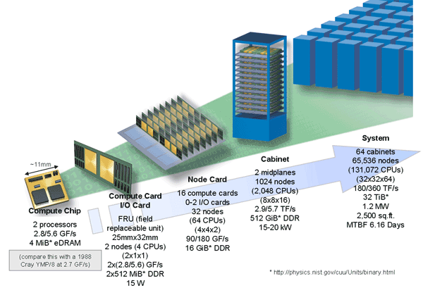
BG/L Sample Diagram
R27-M0-NA-C:J11-U11
R27-M0-NA-C:J11-U11
Midplane
Compute card*
Rack
Node
*16 cards / node (J02-J17)
for each midplane N0, N4, N8, NC
have and additional I/O card (J18)
Compute chip

Slide 14
BG/L event log*
125,624 filtered log entries (only FATAL error entries are given in the log)
Format:
  Timestamp
  Originating node
  Originating card
  Text-free message
1128621351 R04-M0-N0 J18-U01
Lustre mount FAILED : bglio66 : block_id : location
*Log made publicly available by J. Stearley from Sandia National Labs
http://www.cs.sandia.gov/~jrstear/logs/bgl.gz

Slide 15
Examples of error entries
1135619785 R72-M1-NC J09-U11 parity error in read queue 0...................0
1135780093 R35-M0-N3 J12-U01 machine check interrupt (bit=0x1d): L2 dcache unit write data parity error
1132173448 R46-M1-N8 J04-U11 Error receiving packet on tree network, expecting type 57 instead of type 3 (softheader=0030114e 602d0003 00000002 00000000) PSR0=10011f01 PSR1=00000000 PRXF=00000002 PIXF=00000007
…

Slide 16
Tools usage and sample analysis*
*Results shown in the rest of the presentation are based on a subset of 10,000 entries of Mercury log (MercuryErrorLogTEST.txt)

Slide 17
Tools needed for the analysis
A suite of home-made BASH scripts (tuple count, grouping of the error entries; total 4 scripts)
  the basic scripts can be used sequentially to perform the FFDA of the log;
  the usage of the scripts is described in the presentation;
  students are free to modify/improve or to write further scripts to automate the analysis;
  a baseline ffdatoolset.zip archive is provided to the students.
Matlab & statistics toolbox (TTF estimation, curve fitting, …)

Slide 18
How many failures?
The same problem is reported multiple times in the log
Entries that are possibly related to the same problem must be grouped (or coalesced).
$ head -n 10 MercuryErrorLogTEST.txt
1167637660 tg-c645 PRO tg-c645__+BEGIN HARDWARE ERROR STATE AT CMC
1167637660 tg-c645 PRO tg-c645__Device Error Info Section
[… omissis …]
1167637720 tg-c645 PRO tg-c645__Device Error Info Section
1167637720 tg-c645 PRO tg-c645__Error Map: *
1167655228 tg-c238 DEV tg-c238__+BEGIN HARDWARE ERROR STATE AT CPE
1167655228 tg-c238 DEV tg-c238__+Platform PCI Component Error Info Section
[… omissis …]
Notes:
Unix timestamp https://www.unixtimestamp.com/index.php

Slide 19
How many failures?
error
error
detector
fault
log entry
t
The same fault can be activated multiple times and generate multiple errors that propagate within the system.

Slide 20
Determining the coalescence window

Slide 21
How many failures?
The script tupleCount_func_CWIN.sh analyzes how the tuple count varies for increasing values of the coalescence window
Execution takes several min/hour depending on the number of entries in the log*
The output (CWIN,tuple-count pairs) is saved in the tupleCount-<log_filename>.txt file
$./tupleCount_func_CWIN.sh MercuryErrorLogTEST.txt tentative-Cwin.txt
$ cat tupleCount-logMERCURY-TEST.txt
1 2049
2 1238
3 1063
1033
[… omissis …]
CWIN size
count
*around 1hour for the MercuryErrorLogTEST.txt log; estimated around 6/7hours for the exercise log (run with an Intel Core2 Duo @2.4Ghz processor)

Slide 22
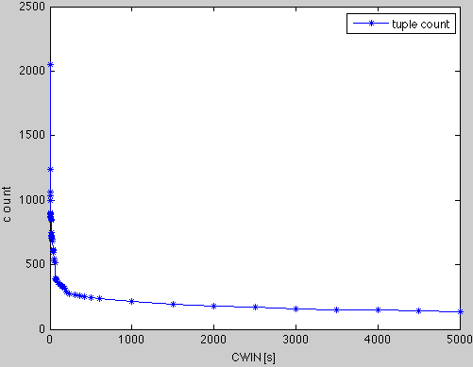
Determining the “optimal” CWIN
Plotting the tuple-count curve
Rule: a good CWIN is
right after the “knee” of
the curve
CWIN: 240sec (4min)
276 tuples
>> load tupleCount-MercuryErrorLogTEST.txt
>> plot(tupleCount_MercuryErrorLogTEST (:,1),tupleCount_MercuryErrorLogTEST (:,2),'-*b');
>> xlabel('CWIN [s]');ylabel(’count’);
>> legend('tuple count');

Slide 23
Grouping the entries with the selected CWIN
The script tupling_with_CWIN.sh coalesces the entries with the selected CWIN (the script takes around 2min).
Output (summary files + content of each individual tuple) is saved in the directory tupling_<log-filename>-<CWIN>
$ ./tupling_with_Cwin.sh MercuryErrorLogTEST.txt 240
*** Grouping the entries for CWIN=240 ***
- creating tuple # 1
- creating tuple # 2
[…]
$ cd tupling_MercuryErrorLogTEST-240/
$ ls
interarrivals.txt tuple_16 tuple_30 tuple_45
lenghts.txt tuple_17 tuple_31 tuple_46
startingPoints.txt tuple_18 tuple_32 tuple_47
tuple_1 tuple_76 tuple_90 […]

Slide 24
Output files
S₁
S₂
S₃
S_{N}
L₁
I₁
L₂
I₂
L₃
I_{N-1}
L_{N}
time
tuple1
tuple2
tuple3
tupleN
L₁ , L₂ , … , L_{N} tuple lenghts (lenghts.txt)
I₁ , I₂ , … , I_{N-1} interarrivals (interarrivals.txt)
S₁, S₂ , … , S_{N} timestamps of the init point of the tuples (1st column ofstartingPoints.txt)
* NOTE: each interarrival is a TTF sample *

Slide 25
Issue #1: truncations
A single failure might be broken into multiple tuples
Tuple #4
…
1167657550 tg-c238 MEM Physical Address x, Address Mask: x, Node: x, Card: x, Module: x, Bank: x, Device: x, Row: x, Column: x,
1167657550 tg-c238 MEM Physical Address x, Address Mask: x, Node: x, Card: x, Module: x, Bank: x, Device: x, Row: x, Column: x,
Tuple #5
1167657941 tg-c238 DEV +BEGIN HARDWARE ERROR STATE AT CPE
1167657941 tg-c238 DEV +Platform PCI Component Error Info Section
Time distance between tuples is 390sec

Slide 26
Issue #2: collisions
syslog entry
system
log
t

Slide 27
Issue #2: collisions
syslog entry
system
log
t
Node #1
t
Node #2
t
Node #3
t

Slide 28
Issue #2: collisions
Two independent, overlapping,
Problems → COLLISION
syslog entry
system
log
t
Node #1
t
Node #2
t
Node #3
t

Slide 29
Issue #2: collisions
One problem that propagates
through the nodes → OK
syslog entry
system
log
t
Node #1
t
Node #2
t
Node #3
t

Slide 30
Example
Tuple #61 includes entries produced by 7 nodes! The tuple lasts 1244 sec (20 min)
Are the events correlated?
3 tg-c669
3 tg-login1
144 tg-login2
144 tg-login3
2 tg-login4
8 tg-s131
28 tg-s159

Slide 31
Reliability modeling

Slide 32
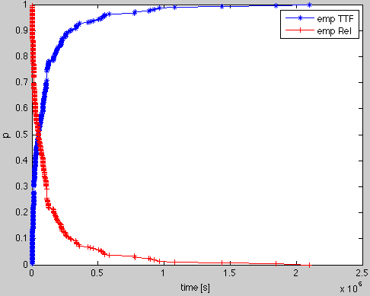
TTF: empirical distribution
The interarrivals.txt file is imported in Matlab to obtain the empirical CDF of the TTF of the system.
>> load interarrivals.txt
>> [y,t]=cdfcalc(interarrivals);
>> empTTF=y(2:size(y,1));
>> empRel=1-empTTF;
>> plot(t,empTTF,'-*b',t,empRel,'-+r');
>> xlabel('time [s]'); ylabel('p');
>> legend('emp TTF', 'emp Rel');
Given t, TTF(t) is the probability that the system exhibits a failure after tsec since the last fail. occurred.
empirical reliability

Slide 33
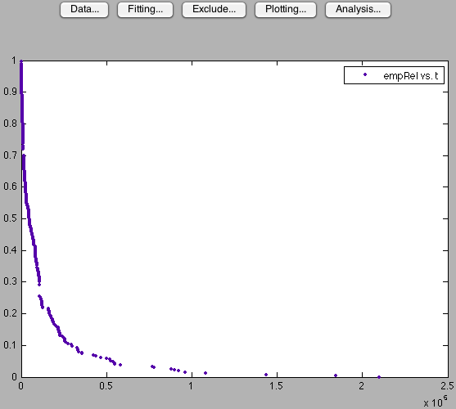
Fitting the empirical reliability
The cftool (statistics toolbox) can be used to fit a theoretical distribution (thRel) to the empirical (empRel) one (“Fitting” button)
>> cftool(t,empRel);
Tentative type of distribution:
exponential
thRel(t) = ae^{bt} a≥0
b<0
empirical reliability

Slide 34
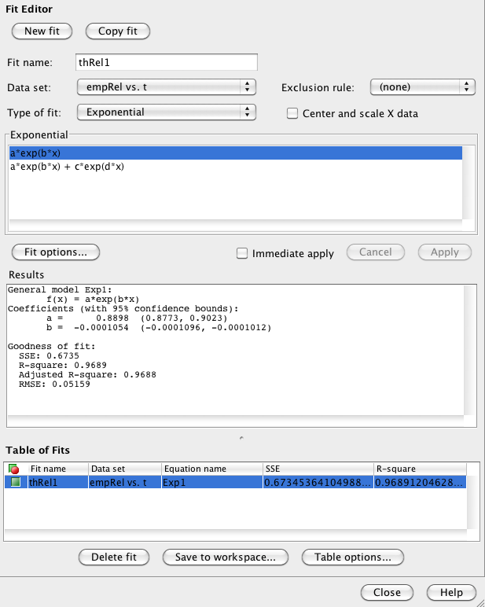
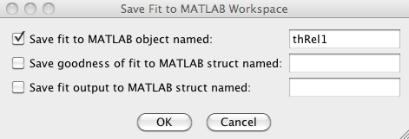
Using the “Fit Editor”
Press “New fit”
Give a name to the fit
Select the type of fit (e.g., exponential)
Select the equation
Press “Apply”
Save the results to Matlab workspace
Coefficients (a and b)
Quality of the fit (SSE, R-square)

Slide 35
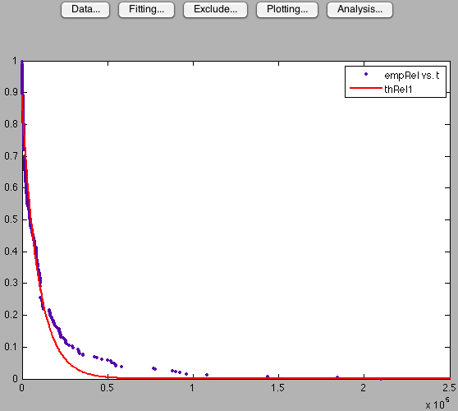
Assessing the quality of the fit
Is the theoretical distribution a good fit for the empirical one?
Indicators:
SSE: Sum of Squares due to
Errors (has to be close to 0)
R-square: “ability” of the fit to
explain the variation in the data
thRel1: SSE=0.6735
R-square=0.9688
Kolmogorov-Smirnov test

Slide 36
Applying the Kolmogorov-Smirnov test
1.) Estimate the maximum distance between empRel and thRel, i.e., D = max(|empRel-thRel|)
2.) Check D against a “critical value”* D_{C} = 1.358 / √N
(N is the number of samples, i.e., empirical points of the curve we are trying to fit)
3.) Result of the test:
- if D ≥ D_{C} the test assumes a significance level ≥95%: we state that thRel is NOT a good fit for empRel.
- else thRel is a reasonable fit for empRel.
*The formula can be applied if N≥100; otherwise D is checked agaist a
table of values (http://oldwww.unibas.it/utenti/dinardo/tavola.html )

Slide 37
K-S test applied to thRel1
thRel1 has been saved to the workspace via the “Fit Editor”
>> D=max(abs(empRel-thRel1(t)))
D =
0.1288
>> size(empRel)
ans =
255 1
>> Dc=1.358/sqrt(255)
Dc =
0.0850
The number of empirical samples can be obtained with size
D_{C} is estimated as described before
*thRel1 is not a goot fit for empRel*

Slide 38
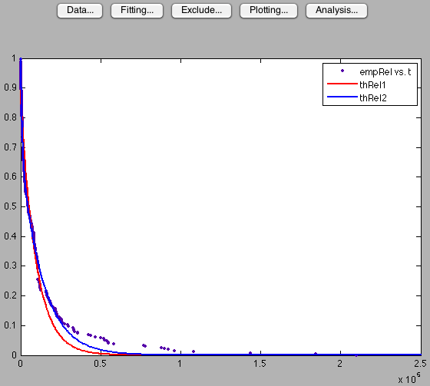
Determining a better fit …
Equation (same steps as for thRel1): thRel2(t) = ae^{bt} + ce^{dt}
Coefficients (with 95% confidence bounds):
a = 0.3681 (0.3531, 0.3831)
b = -0.001078 (-0.001181, -0.0009746)
c = 0.707 (0.6939, 0.7202)
d = -7.398e-05 (-7.615e-05, -7.181e-05)
>> D=max(abs(empRel-thRel2(t)))
D =
0.0611
Dc is the same as before (0.0850)
thRel2 is a goot fit for empRel
(NOTE: but not the only fit,
What about a Weibull distribution?)

Slide 39
Analysis at node/ error-category level

Slide 40
Overview of the log
The script logStatistics.sh provides an overview of the data in the log (useful to
figure out entries-prone
categories and/or nodes)
distribution of the
entries by error category
nodes with the largest
number of entries
$ ./logStatistics.sh MercuryErrorLogTEST.txt
== Total error entries ==
10000
== Breakup by CATEGORY ==
DEV 5576
PRO 1292
MEM 1198
I-O 1195
NET 713
OTH 26
== Breakup by NODE* ==
tg-c572 4030
tg-c238 1272
tg-master 817
tg-c242 622
tg-c648 616
tg-c550 253
tg-c894 217
tg-c284 180
tg-c451 159
tg-s176 156
* only the 10 most occurring nodes are reported

Slide 41
Filtering the log
The script filter.sh is then used to extract entries (by node or category) from the log.
Output is saved in a file named <filterName>-<systemLog>.txt
logFile filterName
$./filter.sh MercuryErrorLogTEST.txt tg-master
Filtering by NODE: tg-master ... [DONE]
$./filter.sh MercuryErrorLogTEST.txt DEV
Filtering by CATEGORY/CARD: DEV ... [DONE]
Filtering can be done either by node or by category
Filtering can be sequential: e.g., all MEM errors of tg-c572
  $./filter.sh MercuryErrorLog.txt tg-c572
  $./filter.sh tg-c572-MercuryErrorLog.txt MEM
  result is MEM-tg-c572-MercuryErrorLog.txt

Slide 42
Error distribution by node
logStatistics.sh applied to a single node returns the most-occurring categories for that node
./logStatistics.sh tg-master-MercuryErrorLogTEST.txt
== Total error entries ==
817
== Breakup by CATEGORY ==
NET 663
I-O 152
OTH 1
DEV 1
== Breakup by NODE* ==
tg-master 817
* only the 10 most occurring nodes are reported

Slide 43
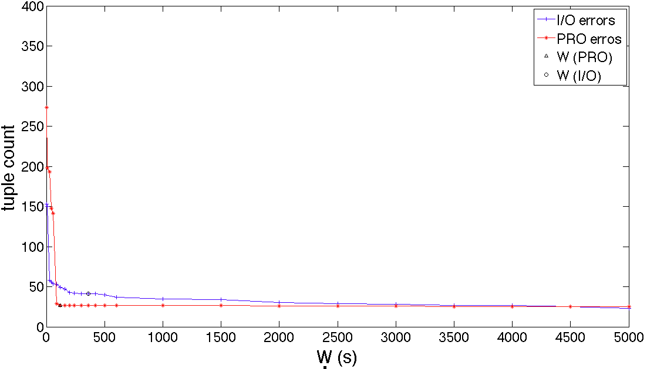
Example: error categories
$./filter.sh MercuryErrorLogTEST.txt PRO
$./filter.sh MercuryErrorLogTEST.txt I-O
$./tupleCount_func_CWIN.sh PRO-MercuryErrorLogTEST.txt tentative-Cwin.txt
$./tupleCount_func_CWIN.sh I-O-MercuryErrorLogTEST.txt tentative-Cwin.txt

Slide 44
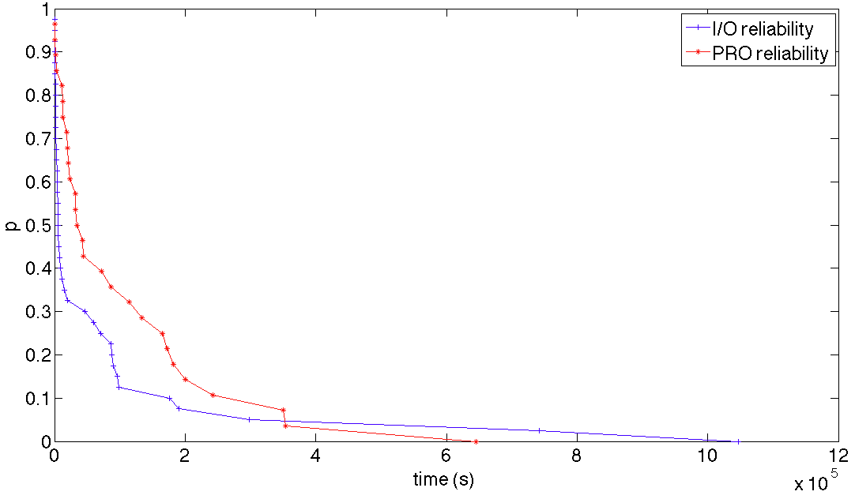
Example: error categories
$./tupling_with_Cwin.sh I-O-MercuryErrorLogTEST.txt 360
$./tupling_with_Cwin.sh PRO-MercuryErrorLogTEST.txt 90

Slide 45
Exercises
Repeat the analysis for MercuryErrorLog.txt and BGLErrorLog.txt:
  tuple count plot + selected CWIN;
  grouping the entries with CWIN;
  empirical distributions;
  fit the empirical reliability (exponential model + other tentative distributions, e.g., weibull);
  analysis of the fit via the K-S test;
  COMPARE RESULTS ACROSS THE SYSTEMS!

Slide 46
Exercises
Conduct the analysis to answer the following questions:
  can the same coalesce windows be used across different nodes (Mercury, BG/L) and error categories (Mercury) ?
  what about the relationship between the system reliability and nodes reliability?
  there exist dependability-bottlenecks (i.e., top-contributors to the total number of failures)?
  do similar functional nodes (e.g., two Mercury tg-cX computing nodes or BG/L I/O nodes Ri:Mx:Nz) exhibit similar reliability parameters?
  there exist a relationship between the error types and the node (Mercury)?
  Whatever additional considerations and results!

